Slide 1
College Council
December 3, 2020

Slide 2
Reporting Committees

Slide 3
Facilities – Cody Pauxtis
HVAC: CO2 Sensors / Programming / MERV 13 Filters.
Automatic Faucets and Soap Dispensers.
New Equipment arriving 17 December.
***Event Forms Must route thru Crystal Leffler: cleffler@cerrococo.edu

Slide 4
Safety & Security – Kevin King
District Provided VAWA Training course
Safety Committee Role as a support element to the COVID Response Team
Removed December and January Meeting dates from Calendar

Slide 5
Technology Resource Team (TRT) – Mike Campbell
Did not meet in November because of the holidays
Next meeting is December 9th (pending finals schedules)

Slide 6
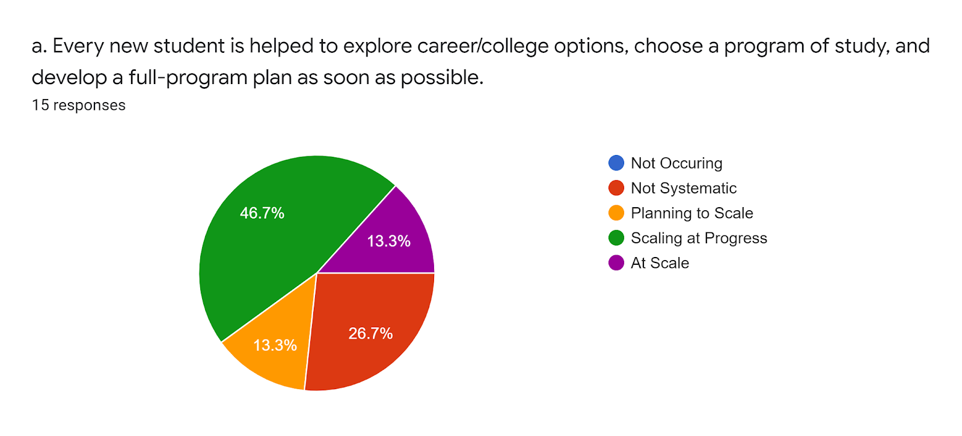
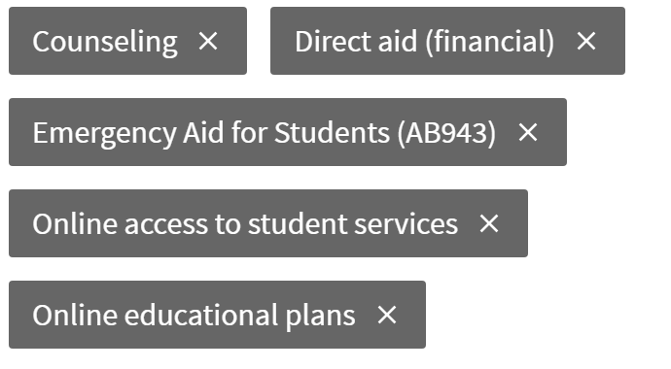
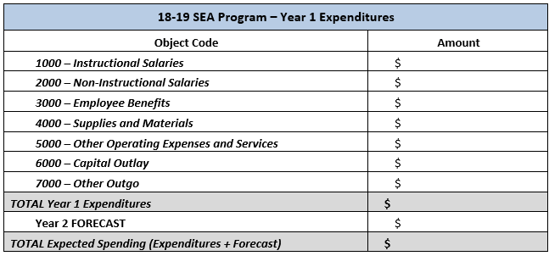
Student Success Support Programs (SSSP) – Heather Ostash
Guided Pathways Scale of Adoption Assessment
Not Occurring
Not Systematic
Planning to Scale
Scaling in Progress
At Scale
Student Equity and Achievement Program – Update

Slide 7
Incarcerated Students Education Program – Peter Fulks

Slide 8
Discussion Items

Slide 9
Associated Committees

Slide 10
Budget Development – Lisa Couch
Reviewing COVID-19 funding requests in early Spring 2021
Budget augmentations
Budget software

Slide 11
District Wide Budget Development Committee – Lisa Couch
KCCD Board Finance & Audit Committee meeting on December 9 @ 2:00PM
Discuss district-wide reserve
Subcommittees continuing their work on internal allocation model

Slide 12
Institutional Effectiveness Committee (IEC) – Corey Marvin
Did not meet in November because of the holidays
Next meeting is January 28 (pending finals schedules)
BUT we are scheduled for strategic planning in the spring...

Slide 13
Professional Development Committee – Corey Marvin
Last meeting: Wednesday, November 18.
Flex Day update
Climate survey discussion
Next meeting is scheduled for Wednesday, January 20, 2021

Slide 14
Accreditation – Corey Marvin
No meetings planned
BUT ACCJC required a report this week on our distance and correspondence education plans for the spring. Two previously un-submitted certificates were approved in perpetuity for DE delivery (LVN and EMT) and all prison programs were approved for correspondence education but for only the spring semester. If we have plans beyond that, we must submit formal substantive change proposals.

Slide 15
The End

